Slide 1
Deferred Lighting Explanation
Advanced Real-Time Graphics : GDEV60010-2025-SUG1-2025-SUG2
By Ryan Moakes

Slide 2
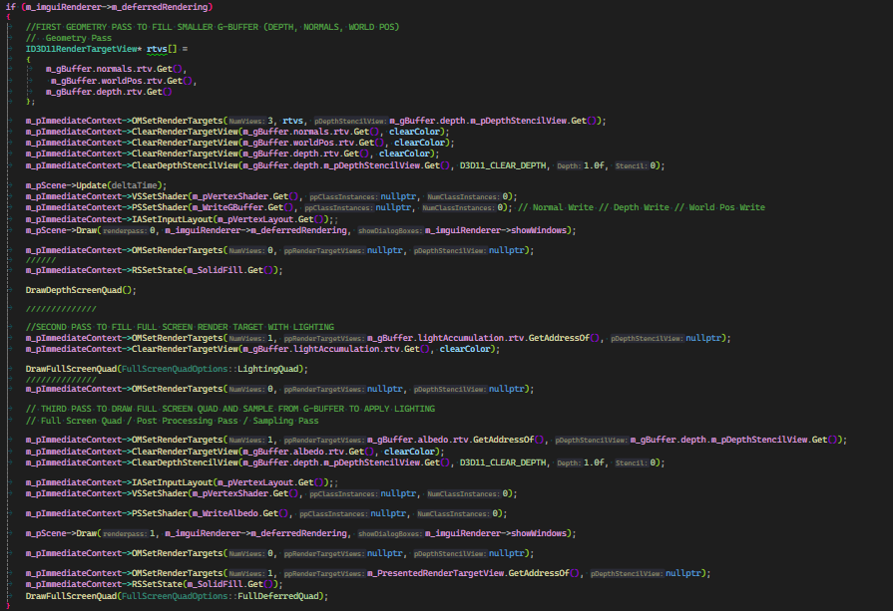
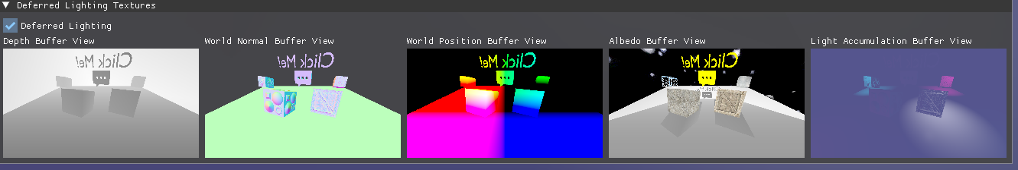
The deferred rendering that was implemented into the advanced rendering framework was a “deferred lighting “ solution. It contains four main render pass steps to render the final image. This is the “geometry” stage, the “light accumulation” stage and the “Shading / Post Processing Stage”. These are the main render stages / passes except for a Sudo render pass stage for the UI to be overlayed on top of the screen.

Slide 3
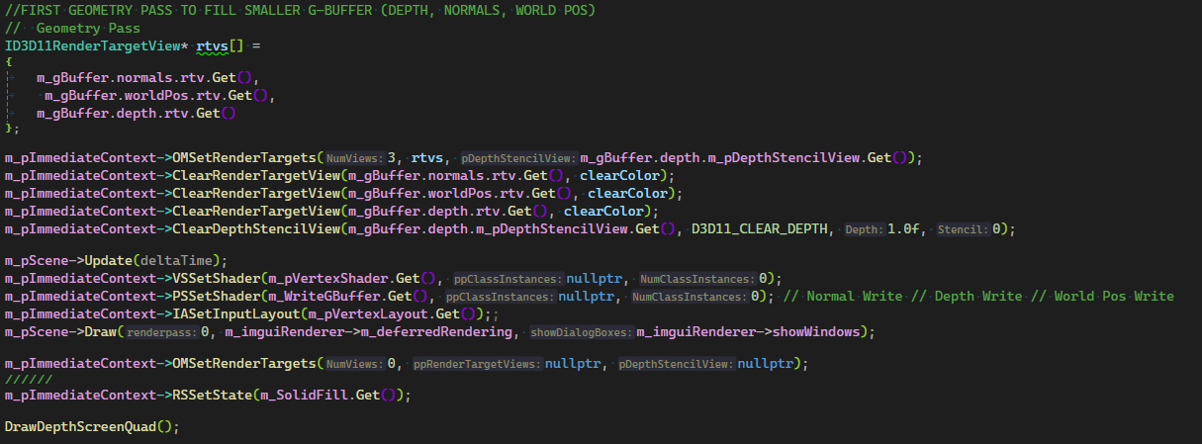
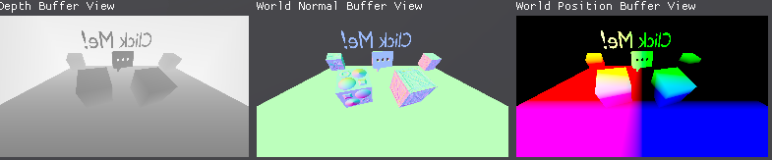
3
The first pass involves the writing of the depth, normal and world position buffers to shader resource views to be used in the next pass. I also wanted to have a depth visualisation buffer so that I could display the depth buffer to the screen. This happens in two separate stages, the 1st pass where the depth, normal and world position is collected, and the second or 1.5th pass where a full screen quad is drawn to get a depth visualisation buffer.

Slide 4
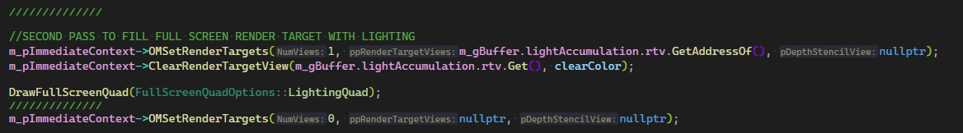
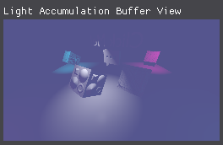
4
The second pass is the lighting accumulation pass which used the previously gained normal, world and depth buffers to apply lighting to the untextured scene.
This is where the main benefit of deferred lighting comes in as the amount of overdraw is significantly reduced by only lighting pixels that will be used in the final rendered image.

Slide 5
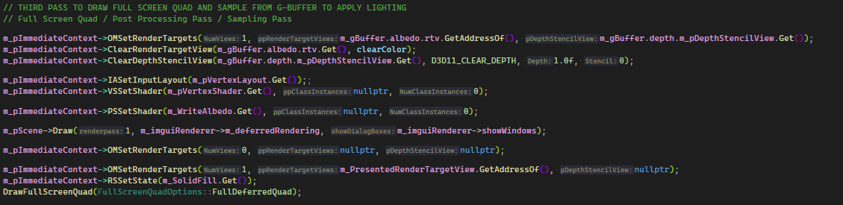
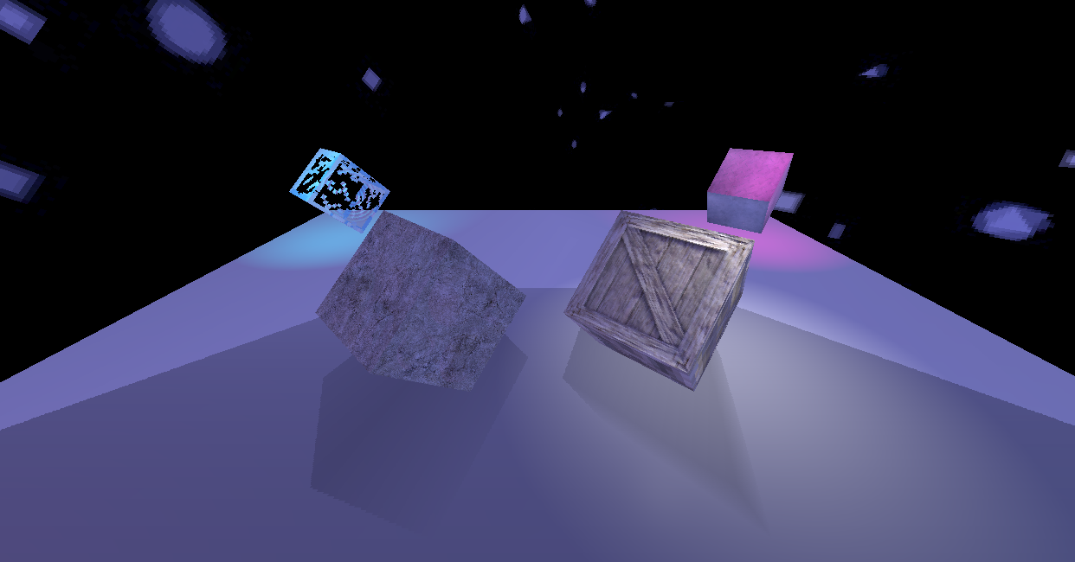
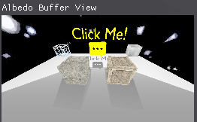
5
The third and final deferred lighting pass is the shading pass in which the scene is drawn again to sample albedo buffer, then a final full screen quad is drawn to apply the scene albedo with the light accumulation buffer to get the shaded scene.
This is also where any post processing effects are added to avoid writing another buffer with shaded scene information for practically no reason.

Slide 6
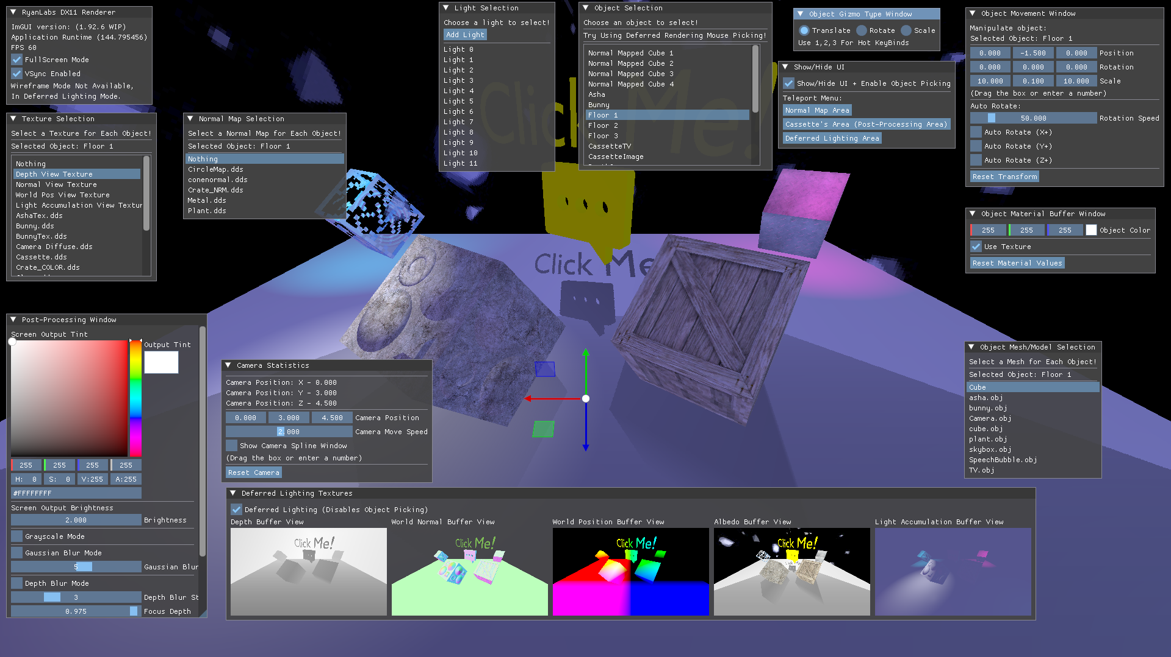
6
The last render pass stage is just drawing the UI onto the final rendered image.

